Slide 1
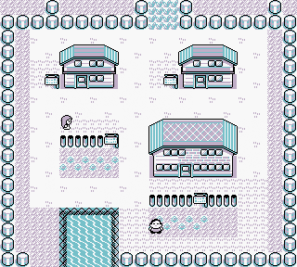
Pokémon : Gotta select * FROM all
Team Rocket Recruits:
Jordan Tiu
Matt Hopkins
Reed Bader

Slide 2

Introduction:
Database to mimic Pokemon Storage System from video game
Pokemon database (Pokedex) with wide variety of attributes (names, type, egg group, etc.)
Trainers in game able to add Pokemon to their collection
Wide variety of queries that can be performed on the database

Slide 3
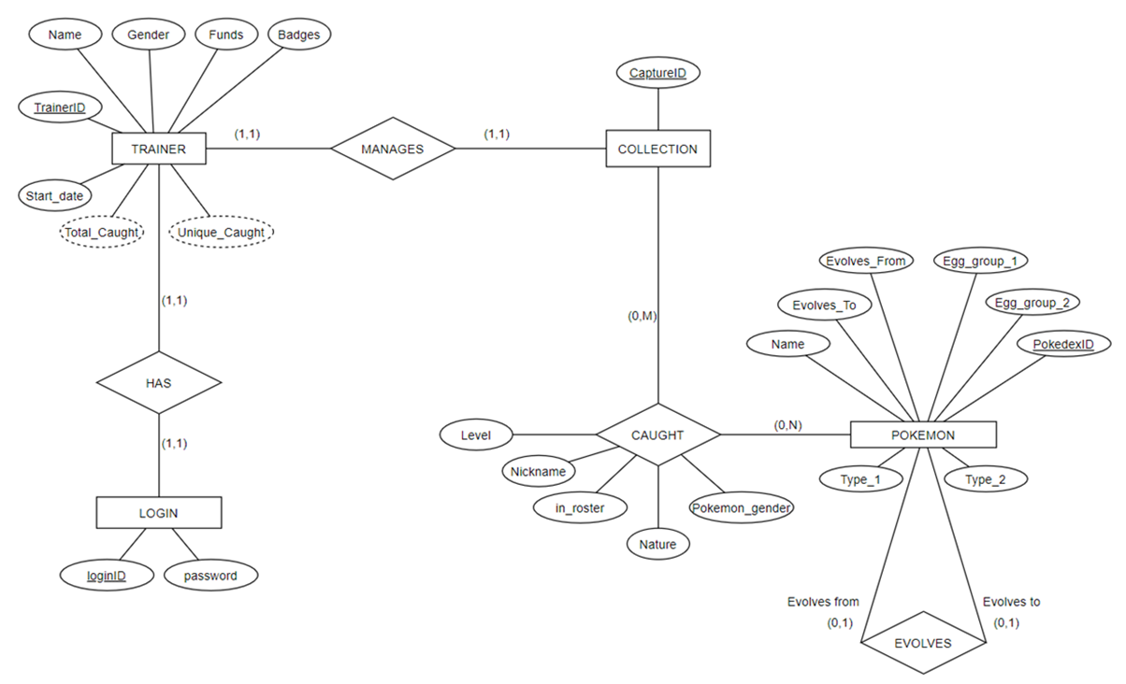
Pokemon Database: ER Diagram

Slide 4
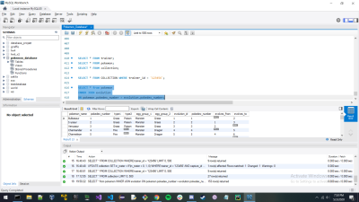
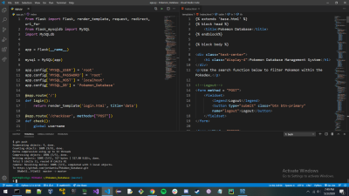
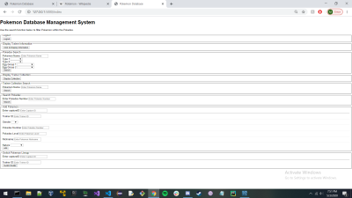
The PC and database of Pokémon
MySQL
Python w/ flask extension & MySQL connector

Slide 5

Issues and Setbacks
Using an ASP.Net framework with C#
Solution – used Python with a Flask extension
Setting up the environment to work in

Slide 6
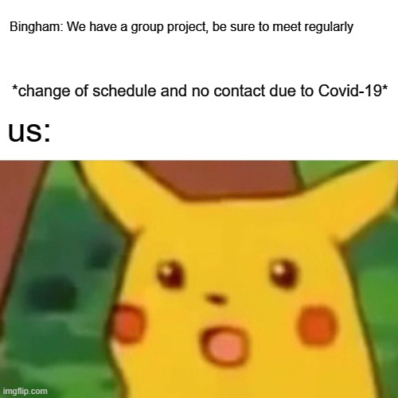
Conclusion
Overall it was a great project and we had a lot of fun learning and building our own database. There are things we could have improved upon, especially the css, but we are happy with our result.

